Slide 1




Slide 2
ADVISOR
DR. MAHA AL-ALABDULJALIL
GROUP MEMBERS
ASMAA SULTAN 2151117051 {LEADER}
AMNA ALI 2131110038 SHARIFA MOUSAED 2121111141

Slide 3
INTRODUCTION

Slide 4
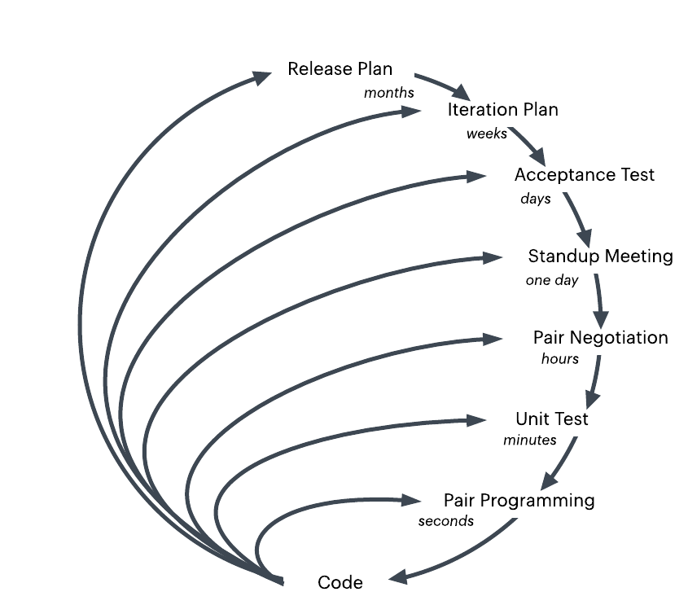
METHODOLOGY : SOFTWARE DEVELOPMENT MODEL
XP

Slide 5

REQUIRED TOOLS
LucidChart
Google Doc
TeamGantt
Phpstrom
cPanel
Microsoft Visual Studio
Bootstrap
phpMyAdmin
MySQL
GitHub

Slide 6



TECHNICAL CHALLENGES
INVALID ADVICES PLAN
FINDING OPTIMAL SOLUTIONS FROM LIMITED OPTIONS
HARDWARE PROBLEMS

Slide 7



PROJECT RISKS
TEAM ISSUES
ALGORITHM COMPLEXITY AND FINDING THE OPTIMAL SOLUTION
SCALABILITY
SECURITY ISSUES

Slide 8

DOCUMENTS
Project proposal.
First report of progress.
Second report of progress.
Final report of progress.
A manual for the student.
A manual for the instructor.
A manual for the general advisor.
A manual for it maintenance team.
Testing documents.

Slide 9

SOFTWARE COMPONENTS
HTML source codes.
CSS source codes.
PHP source codes.
JavaScript source codes.
A WebApp hosted on a server.
MYSQL database.

Slide 10
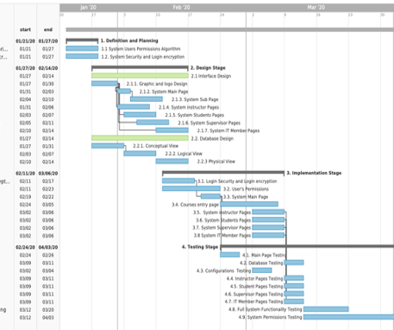
PROJECT PLAN
Distribution of tasks (we will discussion this part with our advisor and T.A.).
Execution plan (Gantt Chart).

Slide 11
SUMMARY
We believe the plan, scope, and approach is best fit for the projects duration and objective.

Slide 12
REFERENCES
Wells, B. D. (n.d.). Extreme Programming: A gentle introduction. Retrieved from http://www.extremeprogramming.org/index.html
Ken Schwaber, J. S. (n.d.). WHAT IS SCRUM? Retrieved from https://www.scrum.org/resources/what-is-scrum
Guo, Y.-L & Ho, C.-W & Ko, Ming-Tat. (2013). The Longest Path Problem on Distance-Hereditary Graphs. Smart Innovation, Systems and Technologies. 20. 69-77. 10.1007/978-3-642-35452-6_9.
Rehfeldt, Daniel & Koch, Thorsten. (2017). Combining NP-Hard Reduction Techniques and Strong Heuristics in an Exact Algorithm for the Maximum-Weight Connected Subgraph Problem.

